Slide 1
Accelerating Your OFFER
-- Machine Learning Practice to Speed Up Application Process
Siyuan Bai, Nan Liao, Lichen Kuai, Bingle Wu, Wenxiao Wu

Slide 2
Data Preprocessing--Cleaning
Sample Job Description
Company Name
"Company Overview\n\n\nAt Memorial Sloan Kettering (MSK), we’re not only changing the way we treat cancer, but also the way the world thinks about it. By working together and pushing forward with innovation and discovery, we’re driving excellence and improving outcomes. For the 28th year, MSK has been named a top hospital for cancer by U.S. News & World Report. We are proud to be on Becker’s Healthcare list as one of the 150 Great Places to Work in Healthcare in 2018, as well as one of Glassdoor’s Employees’ Choice Best Place to Work for 2018. We’re treating cancer, one patient at a time. Join us and make a difference every day.\n\nJob Description:
·······
\n\nYou will:\nSupport agile team in translating end user requirements into set of user product criteria for technical development team & developing documentation\nConnect with team to confirm product commitments\nConduct data analysis and research required for development team to make decisions\nCollaborate with team to understand, analyze, document, and communicate platform requirements\nPartner with key stakeholders to articulate and refine product vision throughout the iteration process\nHelp design team in translating product needs/requirements into deliverable units of work\nAble to synthesize metrics such as: user satisfaction/adoption, quality of products delivered, time-to-market, timely delivery etc···
Job Title (JT)
Normalizing JT into 4 Categories:
Business Analyst
Data Analyst
Data Scientist
Data Engineer
Job Description (JD)
Removing Unnecessary Words/ Sentences
Sentence with Company Name
Sentence with [‘we’, ‘our’]…
Line/ Tab Characters
Symbols
Data Preprocessing
LDA Model
Random Forest
Application
Validation

Slide 3

Data Preprocessing– Feature Mapping I
A Set of Words that contains all the Technical Skills and Tools for Data Related Jobs
tool_keywords = set(['python', 'pytorch', 'sql', 'mxnet', 'mlflow', 'einstein', 'theano', 'pyspark', 'solr', 'mahout',
'cassandra', 'aws', 'powerpoint', 'spark', 'pig', 'sas', 'java', 'nosql', 'docker', 'salesforce', 'scala', 'r',
'c', 'c++', 'net', 'tableau', 'pandas', 'scikitlearn', 'sklearn', 'matlab','keras', 'tensorflow', 'clojure’,…])
skill_keywords = set(['statistics', 'chatbot', 'cleaning', 'blockchain', 'causality', 'correlation', 'bandit', 'anomaly', 'kpi',
'dashboard', 'geospatial', 'ocr', 'econometrics', 'pca', 'gis', 'svm', 'svd', 'tuning', 'hyperparameter', 'hypothesis',
'salesforcecom', 'segmentation', 'biostatistics', 'unsupervised', 'supervised’,…])
Stem Words within the Sets
Intersect Two Set to Obtain a Vector of Feature for Each of the Company
Tokenize the Words within the String then Stem Each Word
Job Description
Data Preprocessing
LDA Model
Random Forest
Application
Validation

Slide 4
LDA Model– Feature Mapping II
Input of the Models
Expected Output
For each of the Job Title
For each of the Job Title
Topic 1:
Job Description (JD)
10 Words with their Probabilities
Tokenize the JD & Count Each Word’s Frequency
LDA
Topic 2:
10 Words with their Probabilities
Remove the Top 500 Commonly Appeared Words
Topic 3:
Remove the Bottom 100 Commonly Appeared Words
10 Words with their Probabilities
Data Preprocessing
LDA Model
Random Forest
Application
Validation

Slide 5
LDA Model– Model Output
Business Analyst
'decision', 'medical', 'procurement', 'physical', 'collaboration', 'judgment', 'quantitative', 'operating', 'skillsstrong', 'party', 'input', 'feedback', 'common'…
LDA_DA +
LDA_DE
LDA_BA +
LDA_DS +
Data Analyst
LDA_List
+
'accuracyadept', 'reportsdevelop', 'setsfilter', 'qualityacquire', 'problemswork', 'bull', 'analyststrong', 'needslocate', 'opportunities', 'flow', 'clearance'…
Pervious Vector From the Research List
Data Scientist
=
'statistical', 'machine', 'learning', 'analytic', 'scientist‘, 'predictive', 'techniques', 'algorithms', 'visualization', 'machine', 'statistical', 'quantitative', 'techniques', 'programming'…
Final Features
Data Engineer
'etl', 'python', 'pipelines', 'big', 'azure', 'engineer', 'aws', 'warehouse', 'bi', 'learning', 'big', 'hadoop', 'azure', 'spark', 'programming', 'python', 'streaming'…
Mapping for each of the Company Job Description to Obtain a New Vector
Data Preprocessing
LDA Model
Random Forest
Application
Validation

Slide 6
Random Forest – Model Constructions
Construct a Random Forest Model for Each of the Job Title
Business Analyst
Data Analyst
Data Scientist
Data Engineer
Business Analyst
Data Analyst
Data Scientist
Data Engineer
1000 Job Description (JD) from current category : Labeled as 1
330 Job Description (JD) from other categories Labeled as 0
Dependent variables (Y): Job Title
Sample Training Data for the Model:
Y = 1 / 0
X = [0.345723, 0.567823,0.7264, 0.13765, …]
Independent variables (X): Vectors from Previous Steps
Model Input
70:30 Training-Testing Splitting
Transforming Words Vectors into Numerical Vectors:
Create Bag of Words for Each of the Model
1 for existence, 0 for nonexistence
Calculate TF-IDF of Each Word
Form into a Numerical Vector for each of Job Posting
Data Preprocessing
LDA Model
Random Forest
Application
Validation

Slide 7
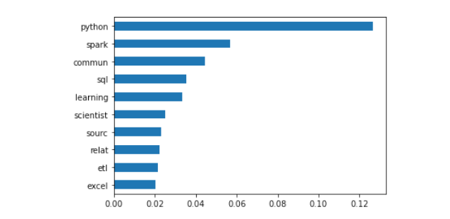
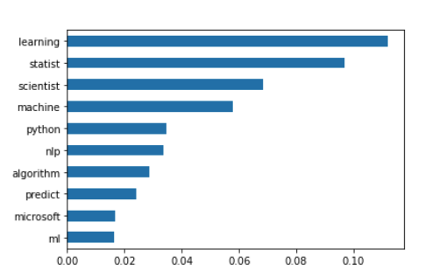
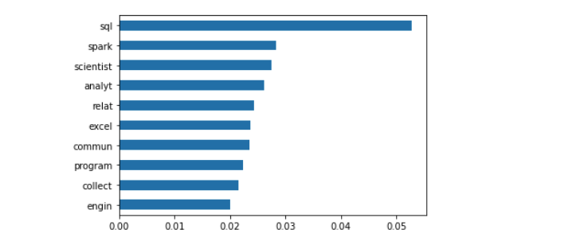
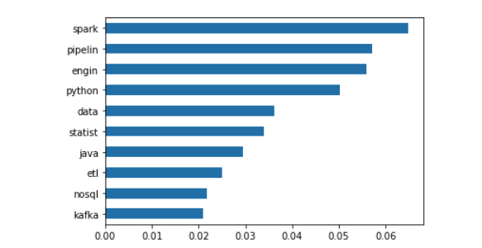
Random Forest – Model Output
Business Analyst
Data Scientist
Accuracy Score:
Accuracy Score:
86%
90%
Data Analyst
Data Engineer
Accuracy Score:
78%
Accuracy Score:
90%
Data Preprocessing
LDA Model
Random Forest
Application
Validation

Slide 8
Model Application
"Who We Are\n\nCisco Security – at Cisco we deliver intelligent cybersecurity for the real world, providing one of the industry's most comprehensive advanced threat protection portfolios that is integrated, pervasive, continuous, and open. Cisco's threat-centric approach to security reduces complexity while providing unmatched visibility, continuous control and advanced threat protection.\n\nWho You Are\n\nAs an Security Licensing Specialist, you will assist in support tickets related to licensing questions and concerns. Looking for a candidate who can review business processes and make process improvement recommendations.\n\nThis role offers the extraordinary opportunity to interact with all parts of the business. Not only does it require a high-touch customer interface, but it also puts you in direct contact with Product, Sales, Renewals, Marketing, Engineering, UX, and Support. You will have the opportunity to use, showcase, and grow your operations skills, drive internal programmatic changes to better service our customers, and be part of an amazing Cisco Security Business Group.\n\nWhat You'll Do\nWork closely with various technical and internal support teams to resolve cases related to licensing queries\nEnsure that the quality and frequency of support are consistent with the Cloud Security customer cases\nWork closely with internal teams, including Sales, Renewals, Business Systems, Sales Operations, to ensure the successful resolution of all licensing related queries.\nCreate and maintain documentation for processes and workflows as needed.\nTrack progress and follow up on cases created by customers, partners and internal teams\nMinimum Qualifications\n3+ years’ work experience in an equivalent capacity\nExcellent communications skills both written and verbal\nA true passion for customers and customer success\nExperience with SaaS-based applications and services\nSelf-starter, high energy, positive attitude, customer focused, detailed oriented\nBachelor's degree or equivalent experience\nStrong customer service, management, listening, and presentation skills\nAbility to juggle multiple tasks\nExperience with SaaS-based applications and services\nExperience working with Salesforce and Zendesk a plus\n\nWhy Cisco\n\nThe Internet of Everything is a phenomenon driving new opportunities for Cisco and it's transforming our customers' businesses worldwide. We are pioneers and have been since the early days of connectivity. Today, we are building teams that are growing our technology solutions in the mobile, cloud, security, IT, and big data spaces, including software and consulting services. As Cisco delivers the network that powers the Internet, we are connecting the unconnected. Imagine creating unprecedented disruption. Your revolutionary ideas will impact everything from retail, healthcare, and entertainment, to public and private sectors, and far beyond. Collaborate with like-minded innovators in a fun and flexible culture that has earned Cisco global recognition as an extraordinary place to work. With roughly\n\n10 billion connected things in the world now and over 50 billion estimated in the future, your career has exponential possibilities at Cisco.\n\nWe are an equal opportunity employer and value diversity at our company. We do not discriminate on the basis of race, religion, color, national origin, gender, sexual orientation, age, marital status, veteran status, or disability status."
Data Preprocessing
LDA Model
Random Forest
Application
Validation

Slide 9
Validation
Data Preprocessing
LDA Model
Random Forest
Application
Validation

